Slide 1
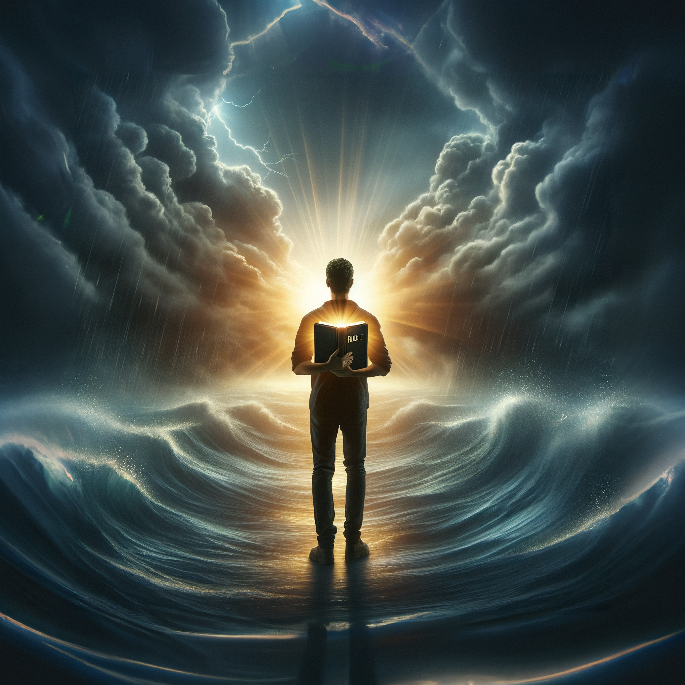
Unless You Repent
Acts 17:29-30
Notes:
Will Gossett ~ September 13, 2026 (Eloy AM)

Slide 2
Acts 17:29-30 NASB
²⁹ Being then the children of God, we ought not to think that the Divine Nature is like gold or silver or stone, an image formed by the art and thought of man.

Slide 3
Acts 17:29-30 NASB
³⁰ Therefore having overlooked the times of ignorance, God is now declaring to men that all people everywhere should repent,

Slide 4
Repent
Hebrew: Shuwb (shoob):
“return or go back, bring back”
Movement back to the point of departure.

Slide 5
Repent
Greek Metanoeo (met-an-o-eh-o): To perceive afterwards. To change one’s mind or purpose.
New knowledge
Regret for the previous course displeasure with self
A change of action

Slide 6
2 Corinthians 7:9-10 NASB
⁹ I now rejoice, not that you were made sorrowful, but that you were made sorrowful to the point of repentance; for you were made sorrowful according to the will of God, so that you might not suffer loss in anything through us.

Slide 7
2 Corinthians 7:9-10 NASB
¹⁰ For the sorrow that is according to the will of God produce a repentance without regret, leading to salvation, but the sorrow of the world produces death.

Slide 8
Acts 17:30-31 NASB
³⁰ Therefore having overlooked the times of ignorance, God is now declaring to men that all people everywhere should repent,

Slide 9
Acts 17:30-31 NASB
³¹ because He has fixed a day in which He will judge the world in righteousness through a Man whom He has appointed, having furnished proof to all men by raising Him from the dead.”

Slide 10
Matthew 12:41 NASB
The men of Nineveh will stand up with this generation at the judgment, and will condemn it because they repented at the preaching of Jonah; and behold, something greater than Jonah is here.

Slide 11
Jonah 3:7-9 NASB
⁷ He issued a proclamation and it said, “In Nineveh by the decree of the king and his nobles: Do not let man, beast, herd, or flock taste a thing. Do not let them eat or drink water. ⁸ But both man and beast must be covered with sackcloth;

Slide 12
Jonah 3:7-9 NASB
and let men call on God earnestly that each may turn from his wicked way and from the violence which is in his hands.
⁹ Who knows, God may turn and relent and withdraw His burning anger so that we will not perish.”

Slide 13
Ezekiel 18:30-32 NASB
³⁰ “Therefore I will judge you, O house of Israel, each according to his conduct,” declares the Lord God. “Repent and turn away from all your transgressions, so that iniquity may not become a stumbling block to you.

Slide 14
Ezekiel 18:30-32 NASB
³¹ Cast away from you all your transgressions which you have committed and make yourselves a new heart and a new spirit!
For why will you die, O house of Israel?

Slide 15
Ezekiel 18:30-32 NASB
³² For I have no pleasure in the death of anyone who dies,” declares the Lord God. “Therefore, repent and live.”

Slide 16
Acts 8:21-23 NASB
²¹ You have no part or portion in this matter, for your heart is not right before God.
²² Therefore repent of this wickedness of yours, and pray the Lord that, if possible, the intention of your heart may be forgiven you.

Slide 17
Acts 8:21-23 NASB
²³ For I see that you are in the gall of bitterness and in the bondage of iniquity.”

Slide 18
2 Corinthians 12:20-21 NASB
²⁰ For I am afraid that perhaps when I come I may find you to be not what I wish and may be found by you to be not what you wish; that perhaps there will be strife, jealousy, angry tempers, disputes, slanders, gossip, arrogance, disturbances;

Slide 19
2 Corinthians 12:20-21 NASB
²¹ I am afraid that when I come again my God may humiliate me before you, and I may mourn over many of those who have sinned in the past and not repented of the impurity, immorality and sensuality which they have practiced.

Slide 20
Revelation 2:20-22 NASB
²⁰ But I have this against you, that you tolerate the woman Jezebel, who calls herself a prophetess, and she teaches and leads My bond-servants astray so that they commit acts of immorality and eat things sacrificed to idols.

Slide 21
Revelation 2:20-22 NASB
²¹ I gave her time to repent, and she does not want to repent of her immorality.
²² Behold, I will throw her on a bed of sickness, and those who commit adultery with her into great tribulation, unless they repent of her deeds.

Slide 22
Jonah 3:10 NASB
When God saw their deeds, that they turned from their wicked way, then God relented concerning the calamity which He had declared He would bring upon them. And He did not do it.

Slide 23
2 Peter 3:8-9 NASB
⁸ But do not let this one fact escape your notice, beloved, that with the Lord one day is like a thousand years, and a thousand years like one day.

Slide 24
2 Peter 3:8-9 NASB
⁹ The Lord is not slow about His promise, as some count slowness, but is patient toward you, not wishing for any to perish but for all to come to repentance.

Slide 25
1 John 1:7-9 NASB
⁷ but if we walk in the Light as He Himself is in the Light, we have fellowship with one another, and the blood of Jesus His Son cleanses us from all sin.

Slide 26
1 John 1:7-9 NASB
⁸ If we say that we have no sin, we are deceiving ourselves and the truth is not in us.
⁹ If we confess our sins, He is faithful and righteous to forgive us our sins and to cleanse us from all unrighteousness.

Slide 27
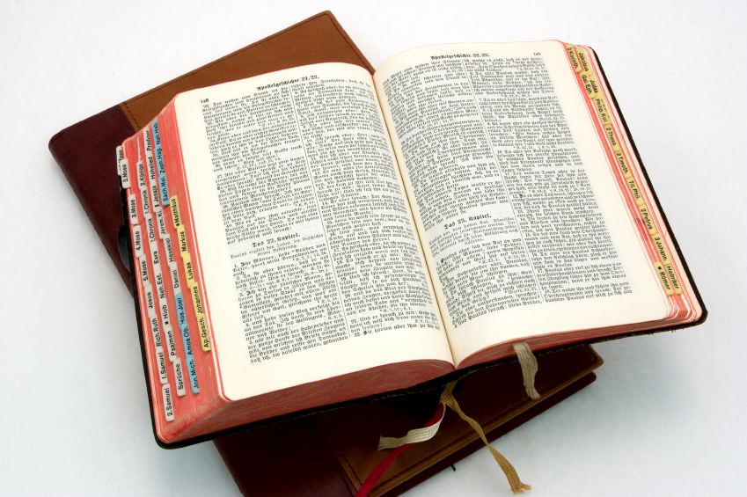
Hear: Romans 10:17
So then faith cometh by hearing, and hearing by the word of God.

Slide 28
Believe: Hebrews 11:6
But without faith it is impossible to please him: for he that cometh to God must believe that he is, and that he is a rewarder of them that diligently seek him.

Slide 29
Repent: Luke 13:3
I tell you, Nay: but, except ye repent, ye shall all likewise perish.

Slide 30
Confess: Matthew 10:32-33
32 Whosoever therefore shall confess me before men, him will I confess also before my Father which is in heaven.
33 But whosoever shall deny me before men, him will I also deny before my Father which is in heaven.

Slide 31
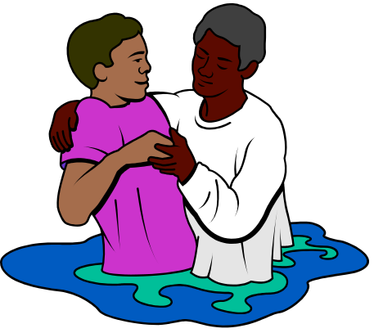
Baptize: Acts 22:16
And now why tarriest thou? arise, and be baptized, and wash away thy sins, calling on the name of the Lord.

